Slide 1
Examples for PSAT
Anonymous

Slide 2
Example 1 PRIMATE Dataset
PSAT PHQ 9 Q1: Text: experiencing sadness like never before so lately i've been feeling really sad and down, i'd say it's a mix of losing touch with someone i loved that made me feel special, starting uni just the whole covid situation not allowing to be around friends for while. every so often, almost daily, get at night, start thinking about all lost can't have right now, regarding friends, lose motivation anything, don't wanna up but also stay in bed doing nothing, do anything force myself go sketch smile on my face worry there. getting point where unliveble this everyday, it, doesn't choice or happy anymore. if there's you guys would suggest try brighten mood love some help. thanks advance.
PSAT PSAT PHQ 9 Q4 : Text: experiencing sadness like never before so lately i've been feeling really sad and down, i'd say it's a mix of losing touch with someone i loved that made me feel special, starting uni just the whole covid situation not allowing to be around friends for while. every so often, almost daily, get at night, start thinking about all lost can't have right now, regarding friends, lose motivation anything, don't wanna up but also stay in bed doing nothing, do anything force myself go sketch smile on my face worry there. getting point where unliveble this everyday, it, doesn't choice or happy anymore. if there's you guys would suggest try brighten mood love some help. thanks advance.
Original Text : experiencing sadness like never before so lately i've been feeling really sad and down, i'd say it's a mix of losing touch with someone i loved that made me feel special, starting uni just the whole covid situation not allowing to be around friends for while. every so often, almost daily, get at night, start thinking about all lost can't have right now, regarding friends, lose motivation anything, don't wanna up but also stay in bed doing nothing, do anything force myself go sketch smile on my face worry there. getting point where unliveble this everyday, it, doesn't choice or happy anymore. if there's you guys would suggest try brighten mood love some help. thanks advance.
PSAT PHQ 9 Q7 : Text: experiencing sadness like never before so lately i've been feeling really sad and down, i'd say it's a mix of losing touch with someone i loved that made me feel special, starting uni just the whole covid situation not allowing to be around friends for while. every so often, almost daily, get at night, start thinking about all lost can't have right now, regarding friends, lose motivation anything, don't wanna up but also stay in bed doing nothing, do anything force myself go sketch smile on my face worry there. getting point where unliveble this everyday, it, doesn't choice or happy anymore. if there's you guys would suggest try brighten mood love some help. thanks advance.

Slide 3
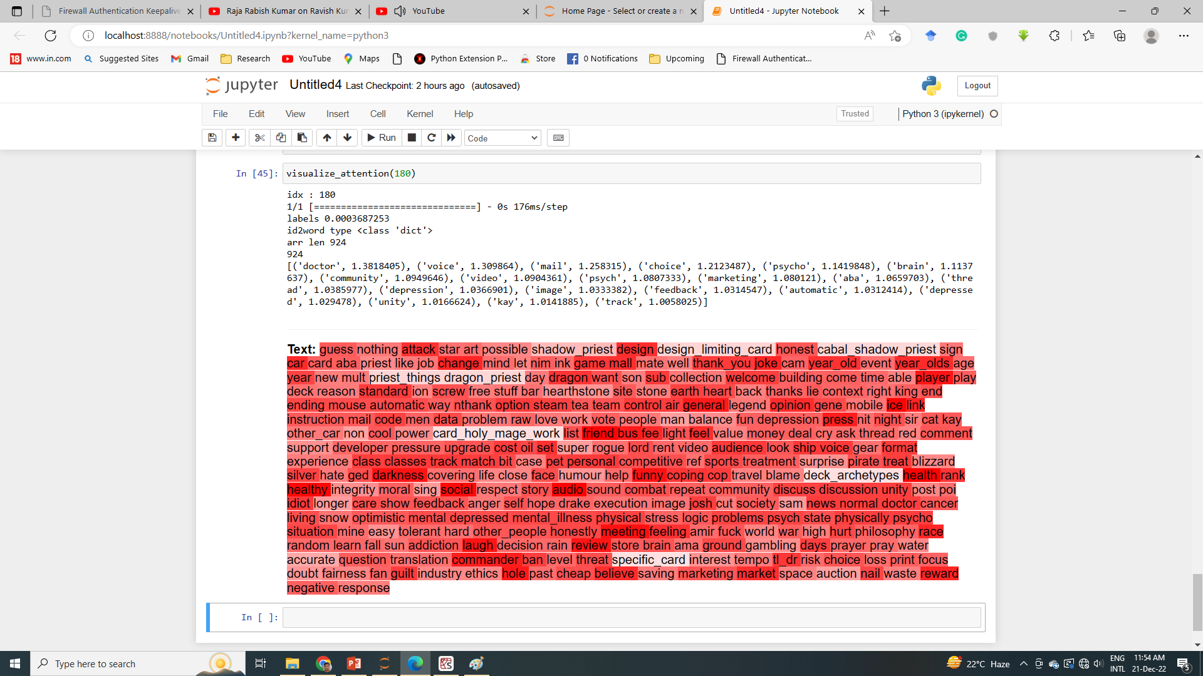
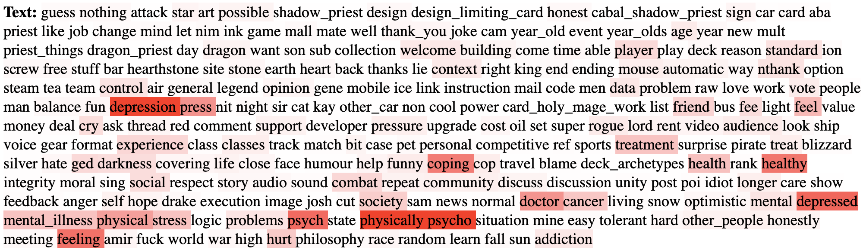
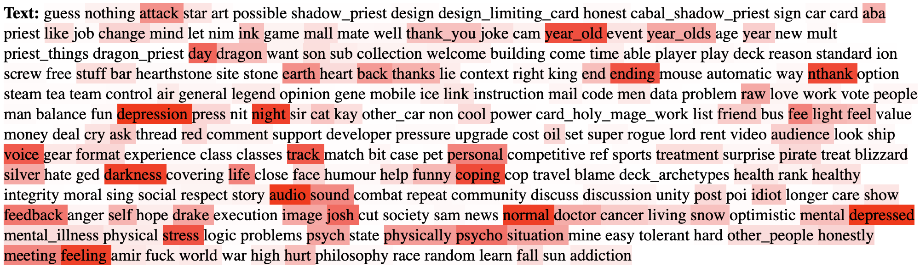
Example 2 CLEF Dataset
Explanation through Self-Attentions is difficult
PHQ-1
Do you Feel Little Interest or Pleasure in Doing Things?
PHQ-2
Do you feel down, depressed, or hopeless?
Notes:
The explanations provided through self-attention is convoluted. To untangle the explanations we need knowledge, which is simple and effective. The knowledge occurs in the form of

Slide 4
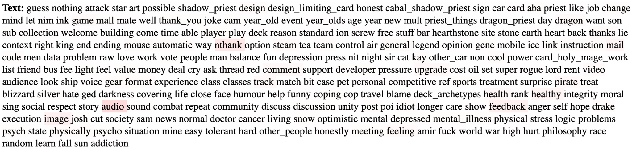
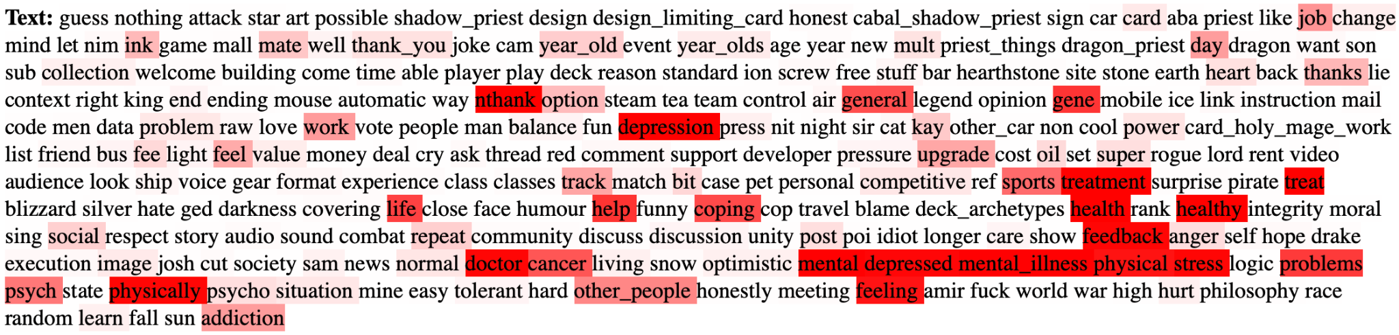
Continue Example 2…
PHQ-3
Are you feeling bothered by trouble falling or staying asleep, or sleeping too much?
PHQ-4
How often have you been bothered by feeling tired or having little energy?

Slide 5
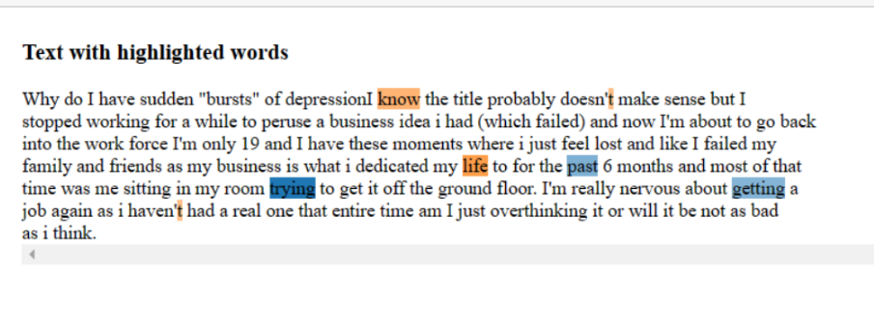
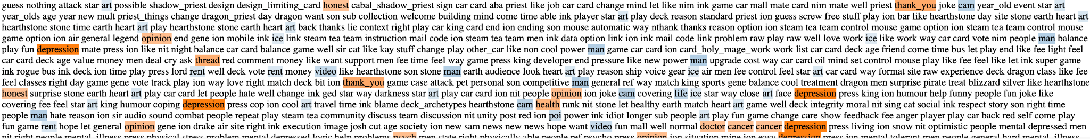
LIME’s Explanations
Example 1 for Lime’s Explanation
Example 2
Notes:
PHQ1, PHQ3, PHQ-5, PHQ-8, PHQ-11 (are the relevant question to ask, but how are we going to ask)

Slide 6
Another Example

Slide 7
(A) Original Text: why do i have sudden bursts of depression know the title probably doesn't make sense but stopped working for a while to peruse business idea had which failed and now i'm about go back into work force only 19 these moments where just feel lost like my family friends as is what dedicated life past 6 months most that time was me sitting in room trying get it off ground floor. really nervous getting job again haven't real one entire am overthinking or will be not bad think.
(B) Self Attention Text: why do i have sudden bursts of depression know the title probably doesn't make sense but stopped working for a while to peruse business idea had which failed and now i'm about go back into work force only 19 these moments where just feel lost like my family friends as is what dedicated life past 6 months most that time was me sitting in room trying get it off ground floor. really nervous getting job again haven't real one entire am overthinking or will be not bad think.
(C) PSAT PHQ 9 Q9: why do i have sudden bursts of depression know the title probably doesn't make sense but stopped working for a while to peruse business idea had which failed and now i'm about go back into work force only 19 these moments where just feel lost like my family friends as is what dedicated life past 6 months most that time was me sitting in room trying get it off ground floor. really nervous getting job again haven't real one entire am overthinking or will be not bad think.
(D) PSAT PHQ 9 Q2: why do i have sudden bursts of depression know the title probably doesn't make sense but stopped working for a while to peruse business idea had which failed and now i'm about go back into work force only 19 these moments where just feel lost like my family friends as is what dedicated life past 6 months most that time was me sitting in room trying get it off ground floor. really nervous getting job again haven't real one entire am overthinking or will be not bad think.
(E) PSAT PHQ 9 Q1 : why do i have sudden bursts of depression know the title probably doesn't make sense but stopped working for a while to peruse business idea had which failed and now i'm about go back into work force only 19 these moments where just feel lost like my family friends as is what dedicated life past 6 months most that time was me sitting in room trying get it off ground floor. really nervous getting job again haven't real one entire am overthinking or will be not bad think.
(F) LIME: why do i have sudden bursts of depression know the title probably doesn't make sense but stopped working for a while to peruse business idea had which failed and now i'm about go back into work force only 19 these moments where just feel lost like my family friends as is what dedicated life past 6 months most that time was me sitting in room trying get it off ground floor. really nervous getting job again haven't real one entire am overthinking or will be not bad think.

